Slide 1
Links
Github Repo
Datasets list
Nuclear dataset
Tensorflow Projector
TSNE
UMAP Observable
Setup notebook

Slide 2

Your stars cluster in evil signs
Tom Roth

Slide 3
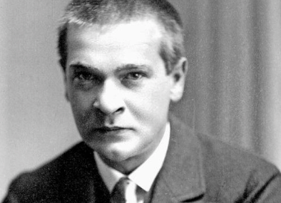
Georg Trakl
A man for every occasion
Networking “For whoever is lonely there is a tavern.” | Family Planning “The guilt of newborns is immense.” | Youth Empowerment “When we are thirsty, we drink the white waters of the pool, the sweetness of our mournful childhood”
Prediction “Black frost. The ground is hard, the air tastes bitter. Your stars cluster in evil signs.” | Thermal Regulation “I do not have easy days at home now and I drift between fear and helplessness in sunny rooms where it is unspeakably cold” | Muscular Development “Shuddering under the autumn stars every year, the head sinks lower and lower”

Slide 4
Many reasons to cluster
Insights / Strategy
Control group
Use on embeddings
Fraud analysis
http://www.terrapattern.com/

Slide 5
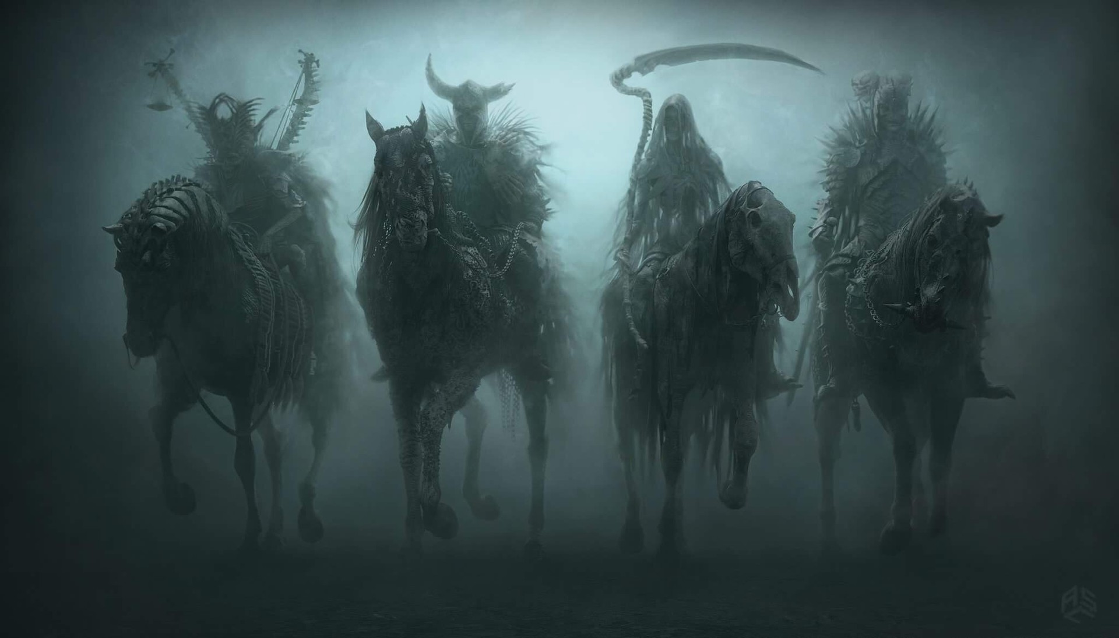
The four horsemen of clustering

Slide 6
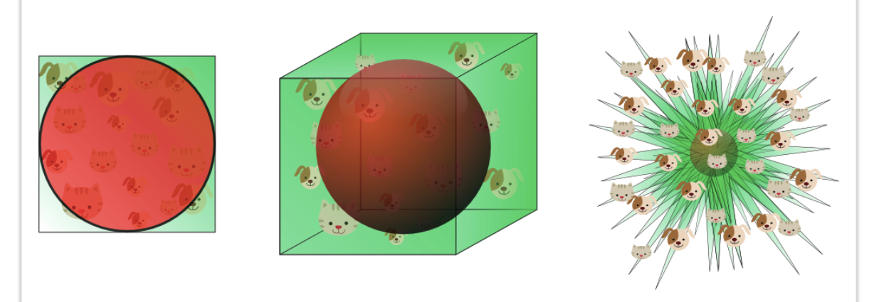
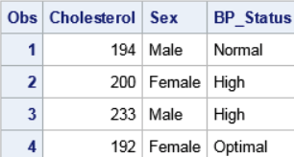
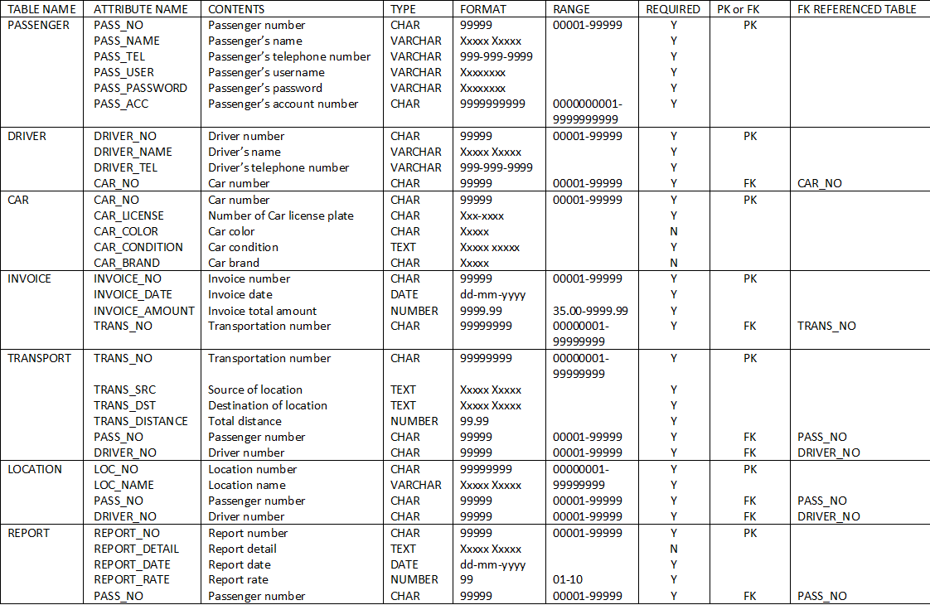
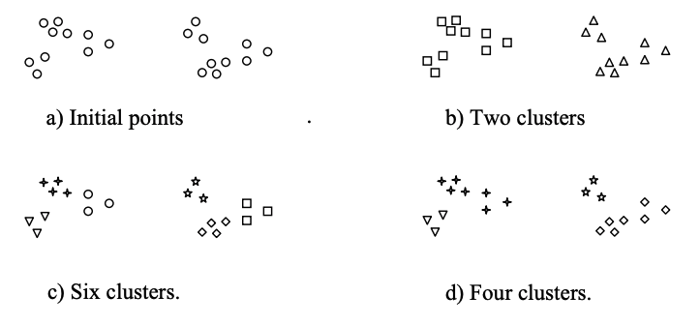
The four horsemen of clustering

Slide 7
Key point #1: High dimensions are trippy
Source: https://www.visiondummy.com/2014/04/curse-dimensionality-affect-classification/

Slide 8
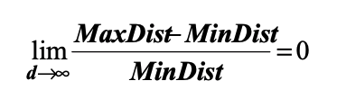
Points lean towards being equidistant
Source: https://www.visiondummy.com/2014/04/curse-dimensionality-affect-classification/

Slide 9
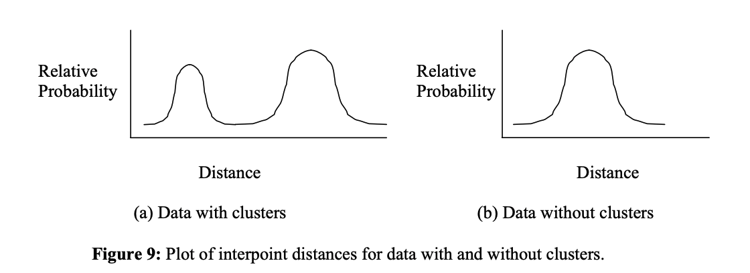
How to tell if clustering might work for you
Source: https://www-users.cs.umn.edu/~ertoz/papers/clustering_chapter.pdf

Slide 10
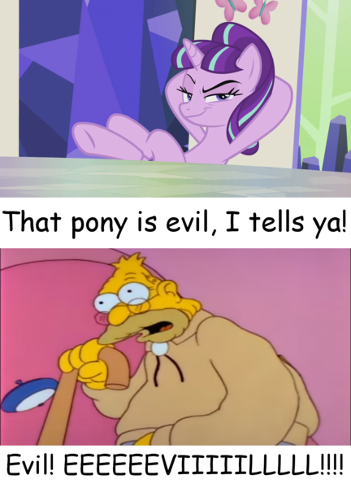
Key point #2:
Categorical variables are evil, I tells ya!

Slide 11
Key point #3: variable selection is everything
Pick 8

Slide 12
Key point #4: it’s art, not science

Slide 13
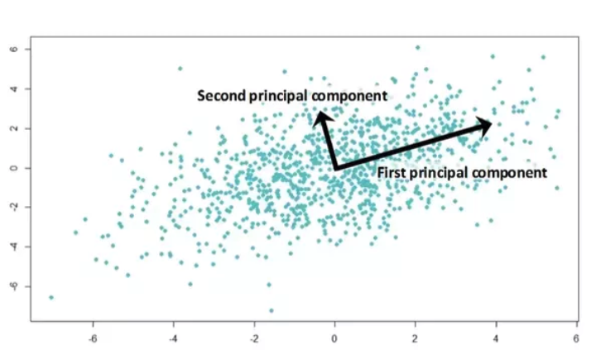
PCA

Slide 14
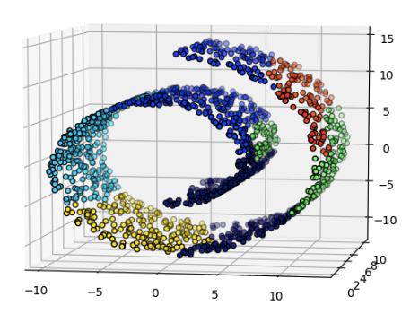
The swiss roll problem

Slide 15
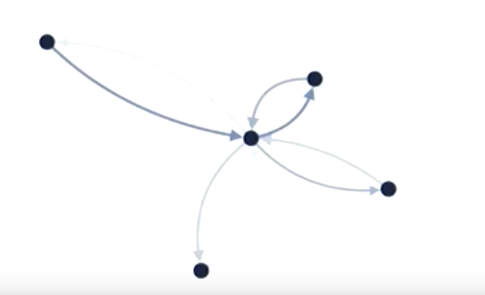
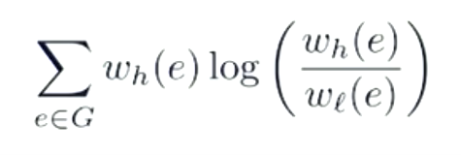
T-SNE

Slide 16

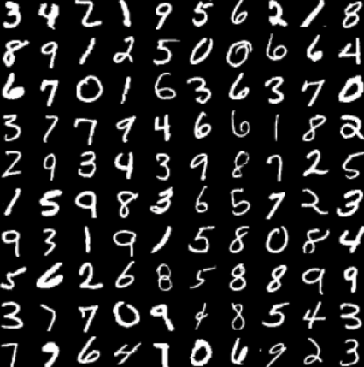
T-SNE

Slide 17
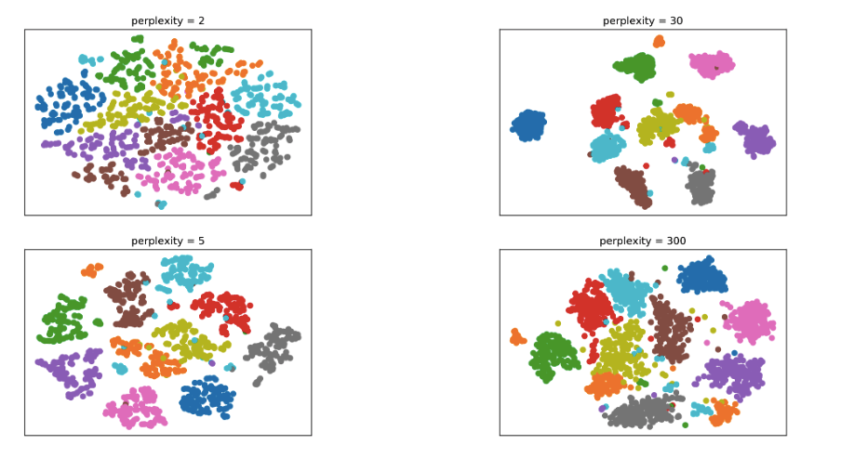
Gotta tune that guy
https://distill.pub/2016/misread-tsne/

Slide 18
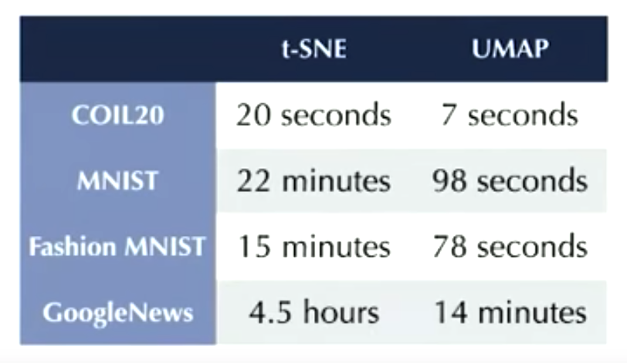
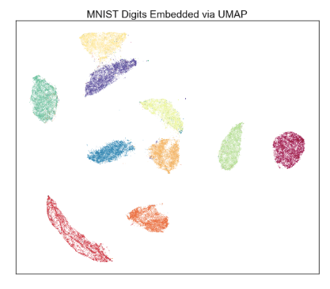
UMAP
https://www.youtube.com/watch?v=YPJQydzTLwQ&feature=youtu.be
https://observablehq.com/@fil/hello-umap-js

Slide 19
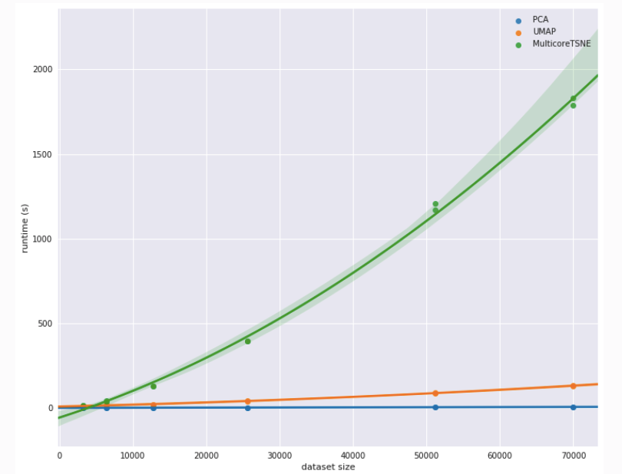

Slide 20
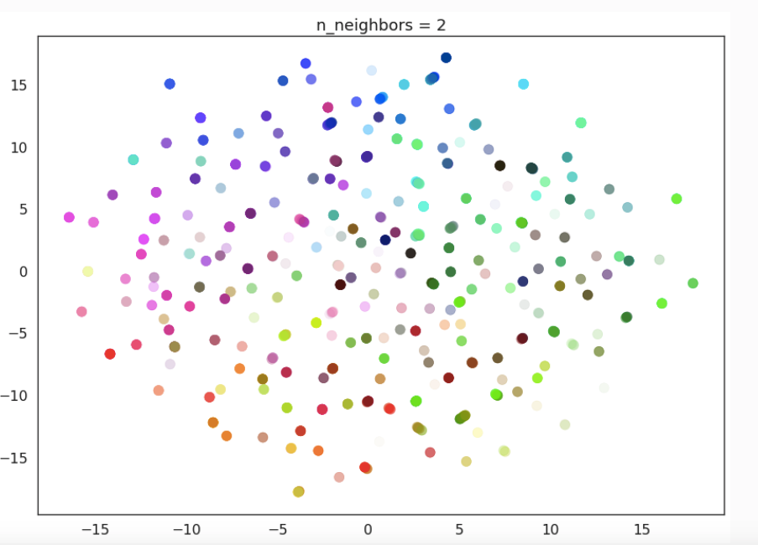
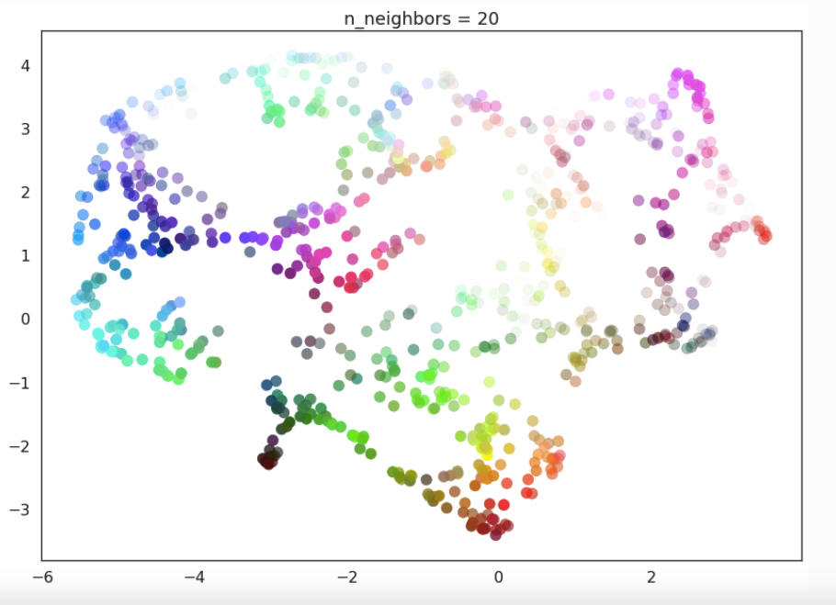
Two main UMAP parameters
https://umap-learn.readthedocs.io/en/latest/parameters.html
n-neighbours: concentrate more on local vs global structure
min-dist: minimum distance between points

Slide 21
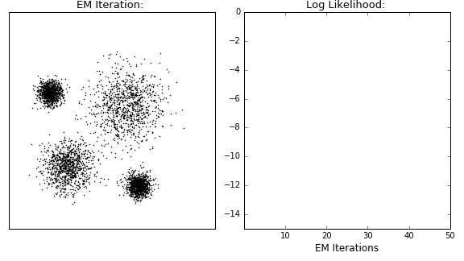
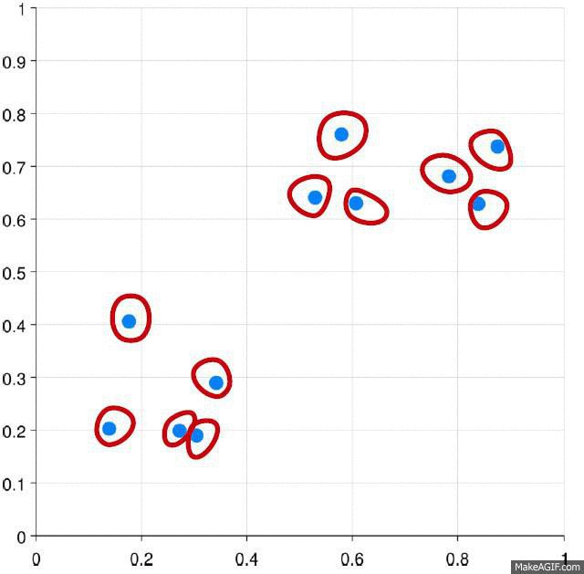

Clustering
https://dashee87.github.io/data%20science/general/Clustering-with-Scikit-with-GIFs/
EM
K-Means
Hierarchical

Slide 22
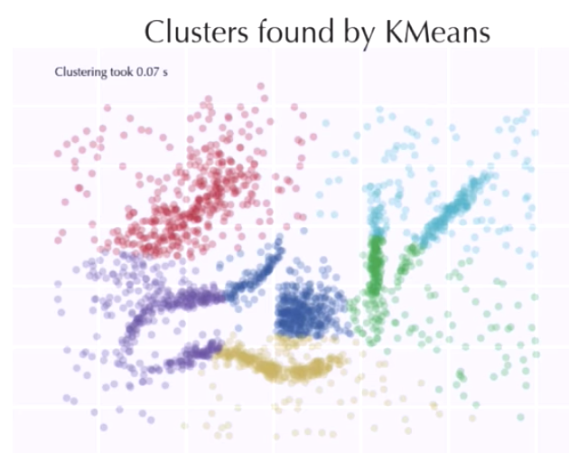
https://www.youtube.com/watch?v=dGsxd67IFiU

Slide 23
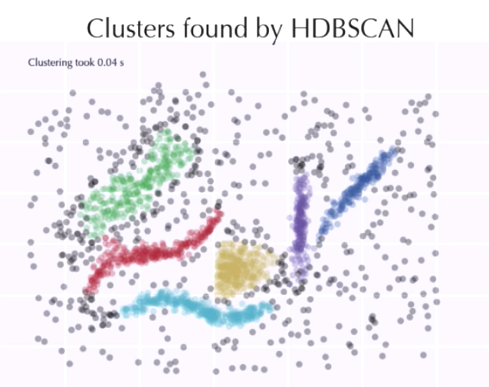
https://www.youtube.com/watch?v=dGsxd67IFiU

Slide 24
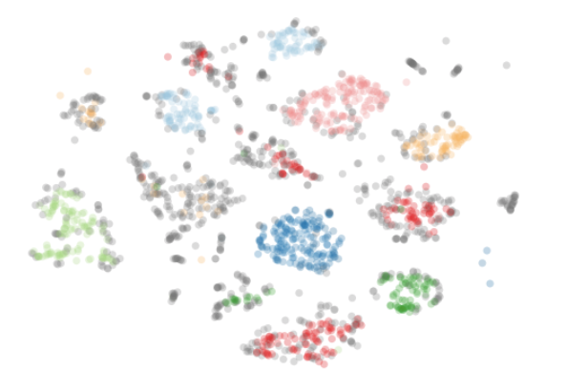
Two main HDBSCAN parameters (familiar?)
https://hdbscan.readthedocs.io/en/latest/parameter_selection.html
min_cluster_size : how many points needed to be considered a “cluster”
min_samples: how conservative to be when assigning points as noise

Slide 25
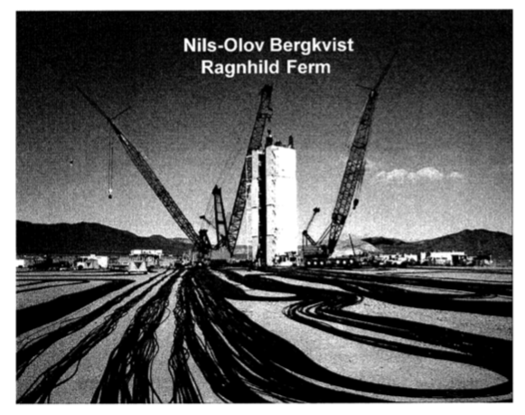
Demo
Data is Plural - big list of unique datasets
Nuclear explosions dataset
Workflow
Data load => data cleaning => variable selection => dim reduction => clustering => visualisation

